Slide 1
Homework 3 Bayes Review
CCM 2023 lab

Slide 2
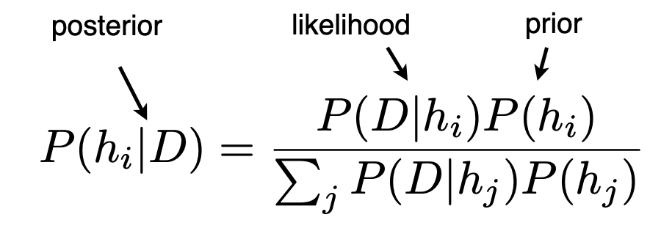
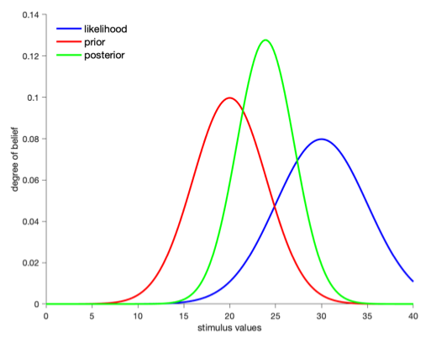
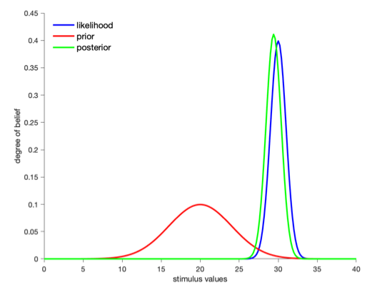
Bayesian inference

Slide 3
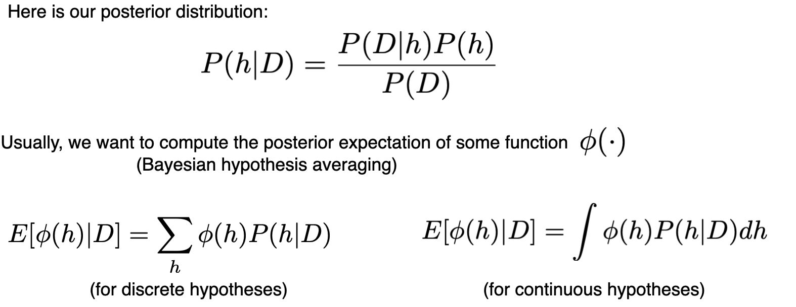
Approximate Bayesian inference
Notes:
Usually we are looking for the posterior mean

Slide 4
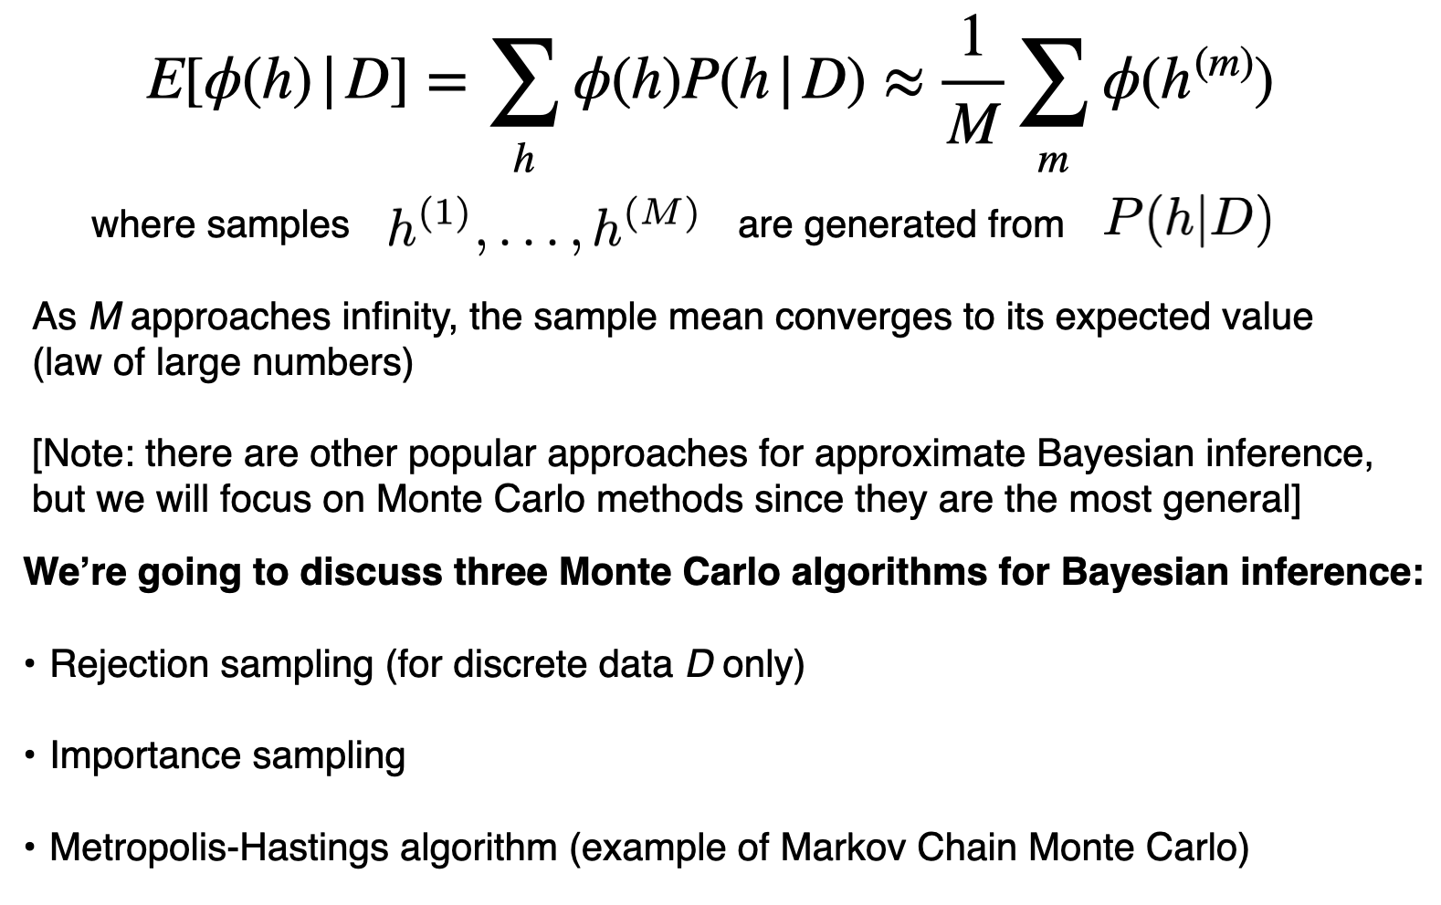
Monte Carlo algorithms (sampling)
HW3 Part B
HW3 Part A
HW3 Part C

Slide 5
HW3 Overview
Part A: Number game
Part B: Probabilistic programming
Part C: Perceptual magnet effect

Slide 6
Part A

Slide 7
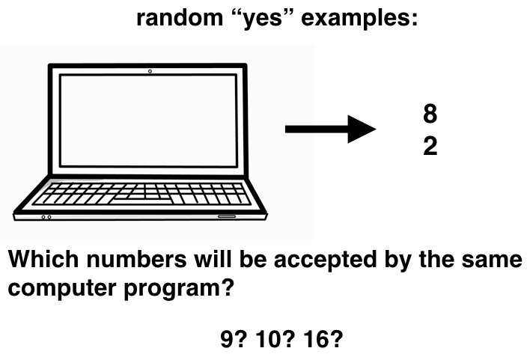
Part A: Number game

Slide 8
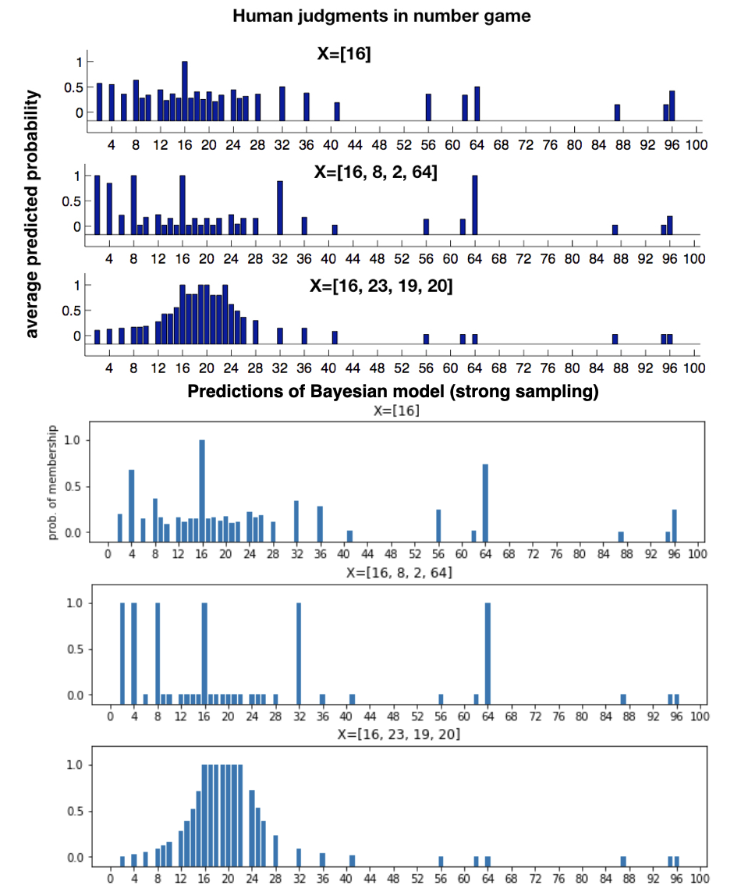
Part A: Goal (fitting human judgements)

Slide 9
Part A: Prior
Two different types of hypotheses: mathematical & interval.
Hypotheses initialization and storage
From hypothesis list to numpy array
Lambda parameter

Slide 10
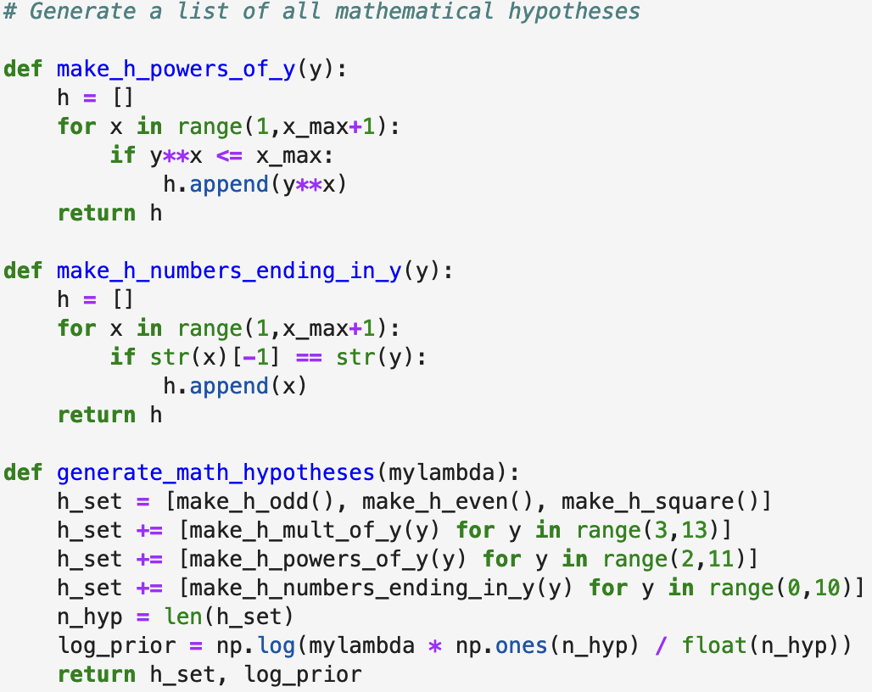
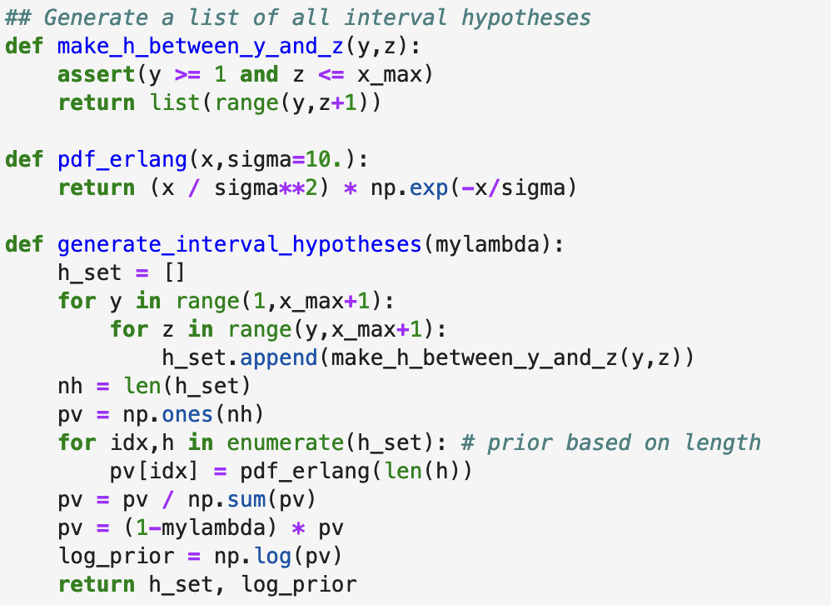
Part A: Let’s look at the code
Intervals of intermediate size are favored (rather than very
small or large hypotheses) by reweighting according to an
Erlang distribution.
Each mathematical hypothesis is given equal weight in the prior.

Slide 11
Part A: Likelihood (size principle)
Notes:
Size principle: hypotheses with smaller extensions are more likely than hypotheses with larger extensions

Slide 12
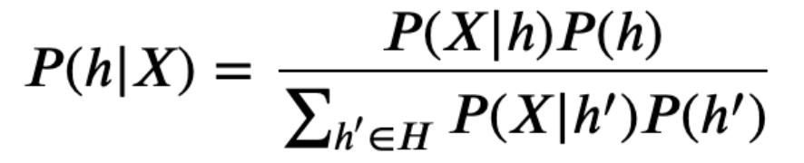
Part A: Posterior
Compute probabilities in logspace
Use logsumexp function for the normalization factor

Slide 13
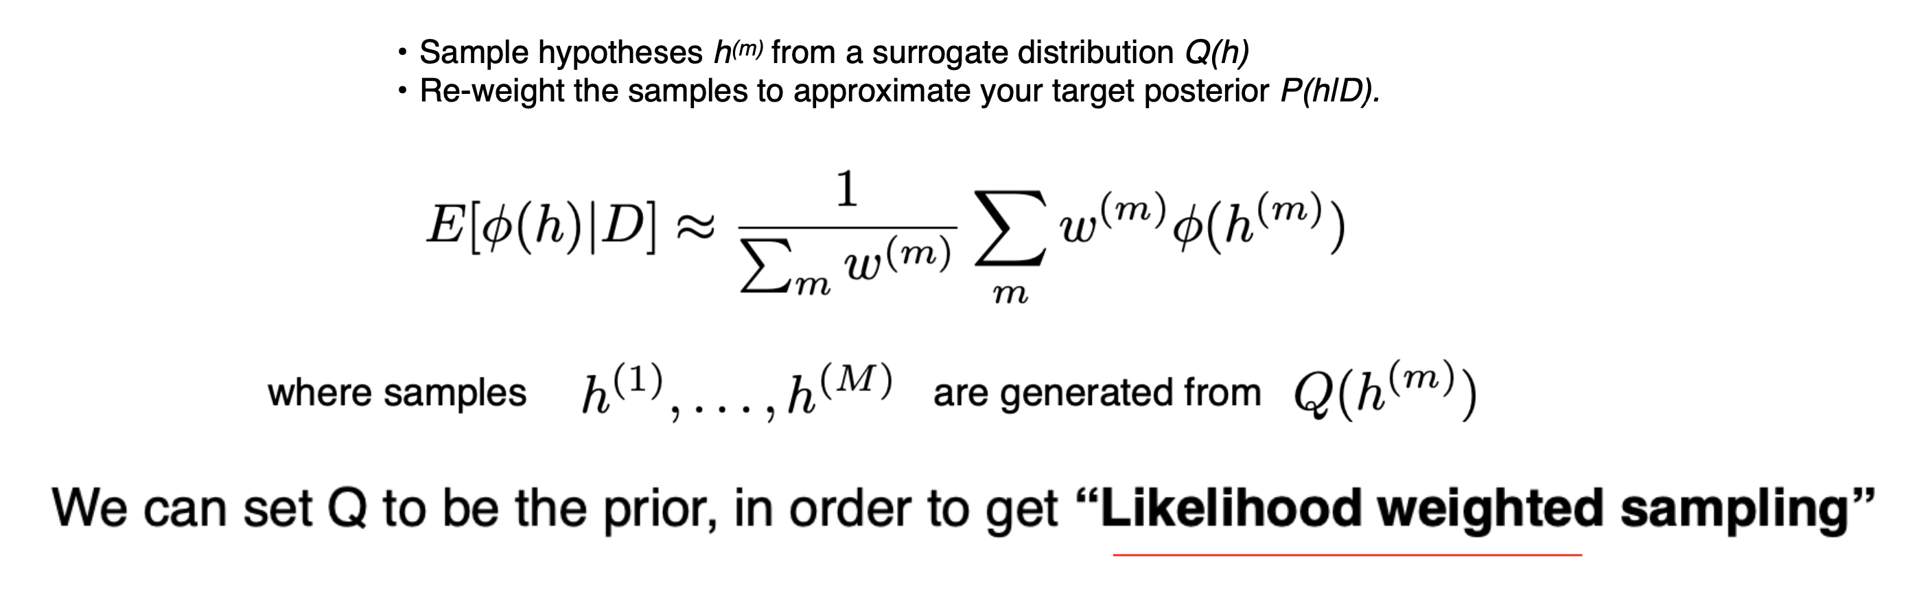
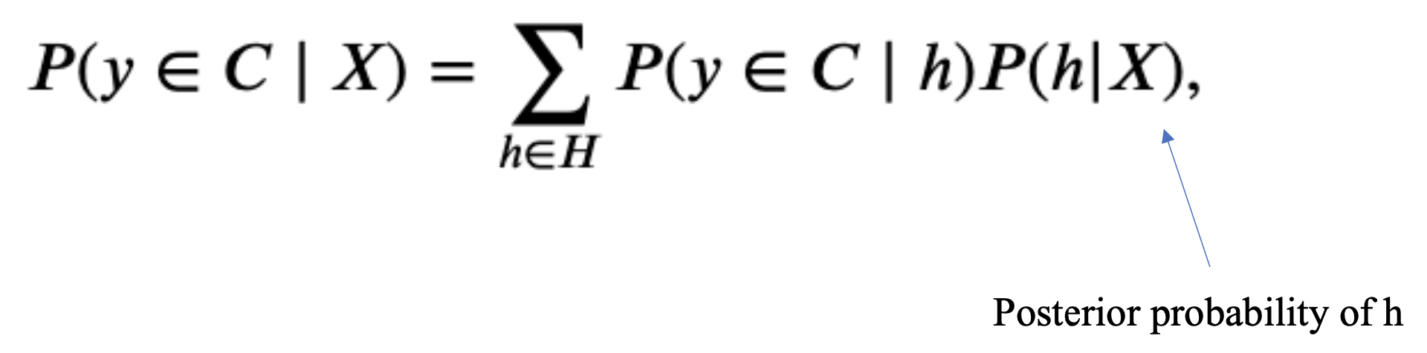
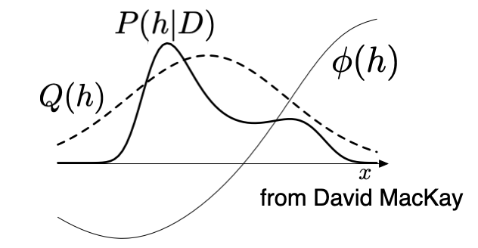
Part A: Make predictions (Likelihood weighted sampling)
Prior
Make posterior predictions about membership of new number y:

Slide 15
Part B

Slide 16

Part B: Probabilistic programming
A series of tennis matches are described in a probabilistic model
We want to use Bayesian inference to reason about parameters in this model, such as a player’s strength

Slide 17
Part B: Model design
Every player has a strength value sampled from Gaussian
Team strength is the sum of two players’ strengths
Random laziness cuts a player’s strength in half
Winners: team with the greater strength

Slide 18
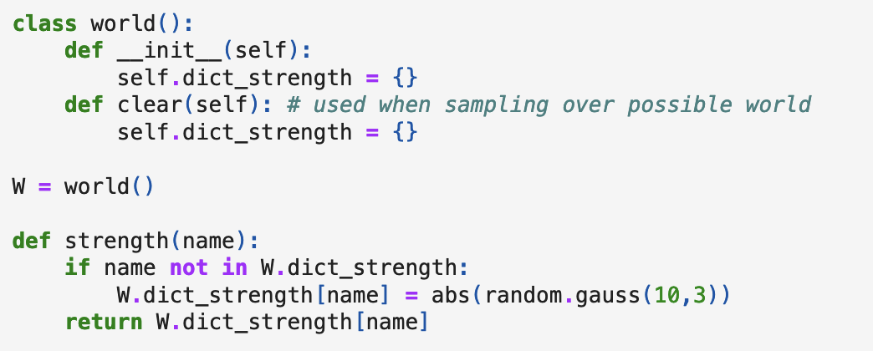
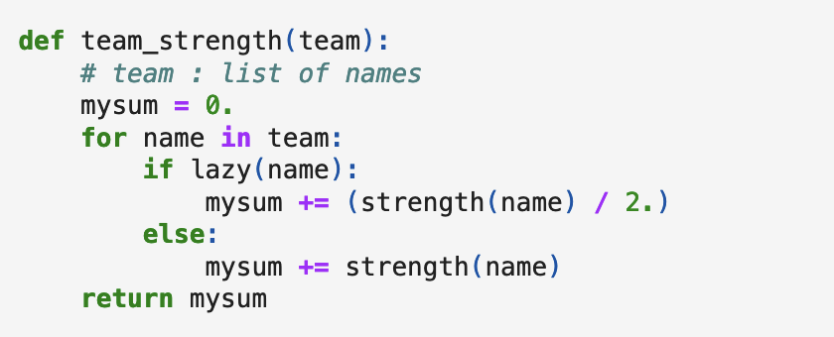
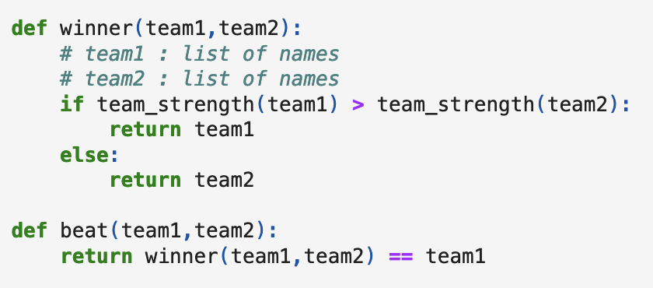
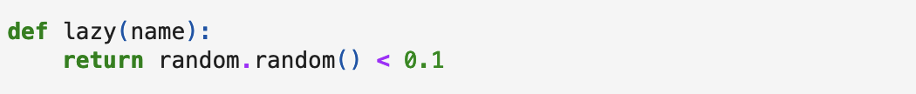
Part B: Let’s look at the code

Slide 19
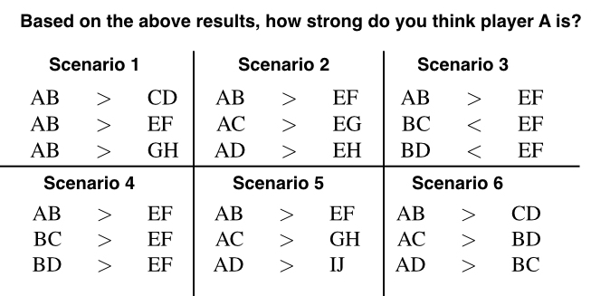
Part B: Goal (fitting human judgements)

Slide 20
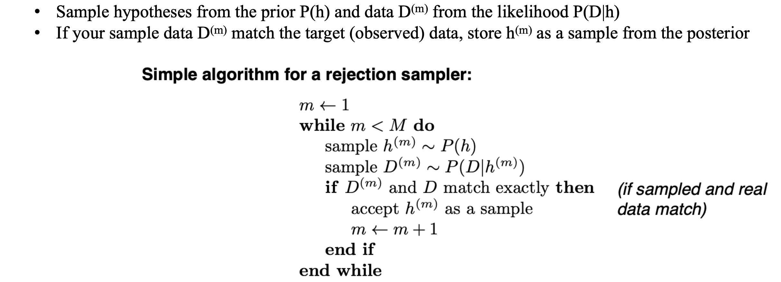
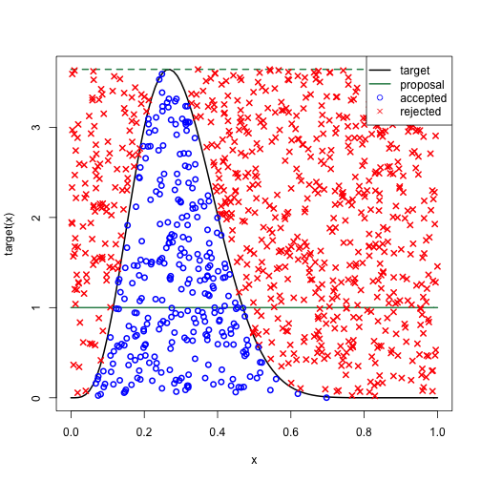
Part B: Rejection Sampling

Slide 21
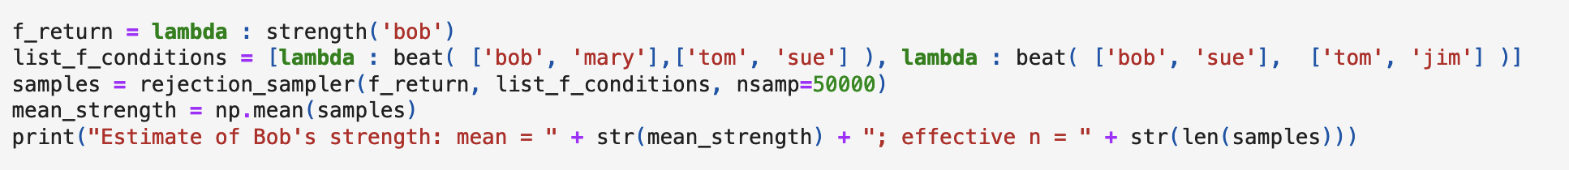
Part B: Rejection sampling for tennis
We can sample a state of the world (player strengths, laziness, match results, etc…)
What are D^{(m)} and D?

Slide 22
Part C

Slide 23
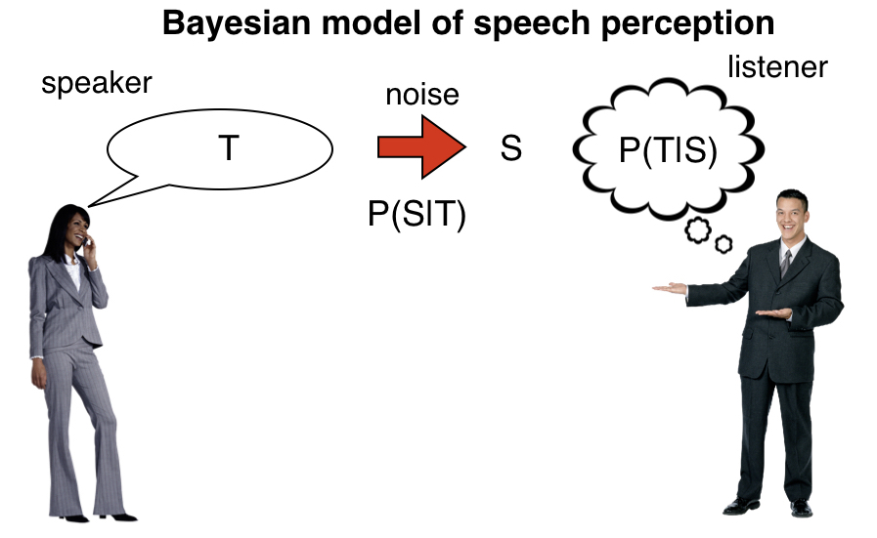
Part C: Perceptual magnet effect

Slide 24
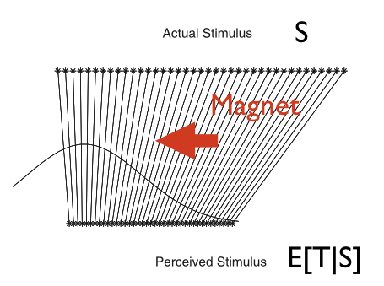
Part C: Goal (warping the stimulus distribution)

Slide 25
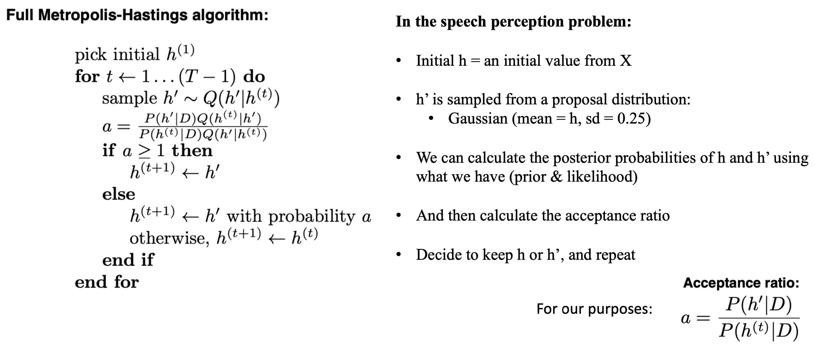
Part C: Metropolis-Hastings algorithm

Slide 26
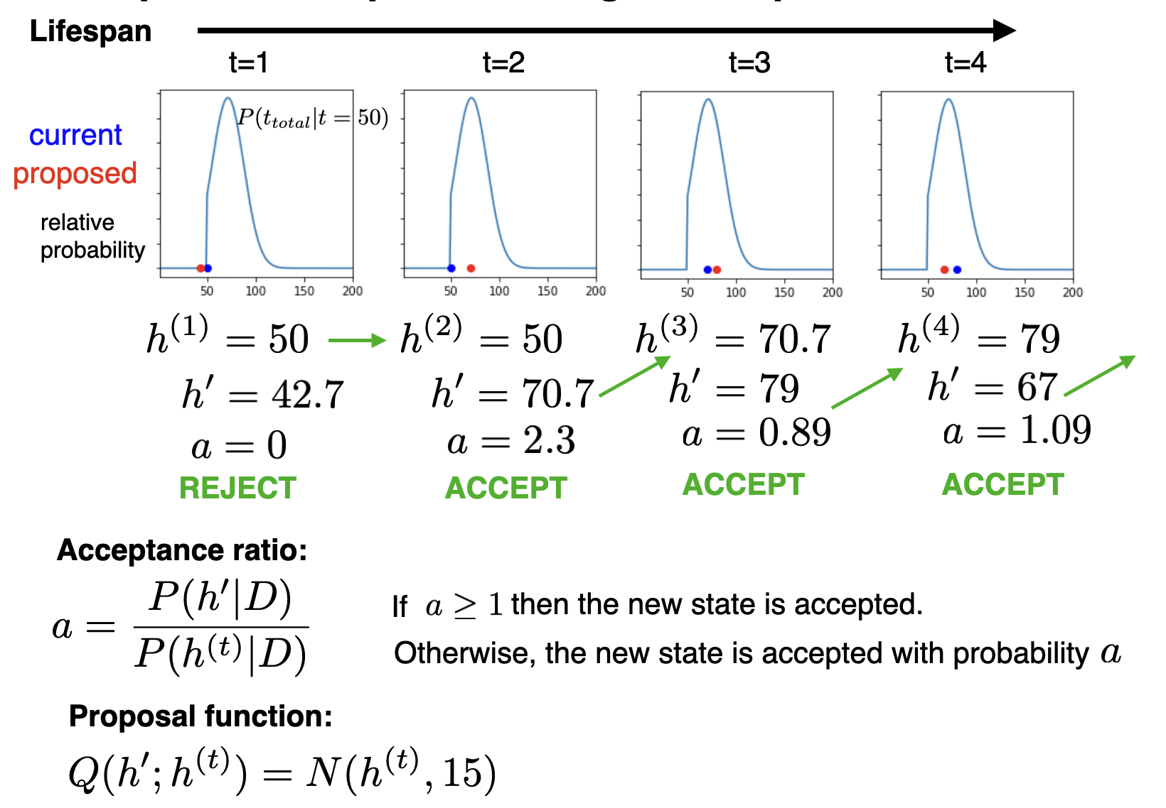
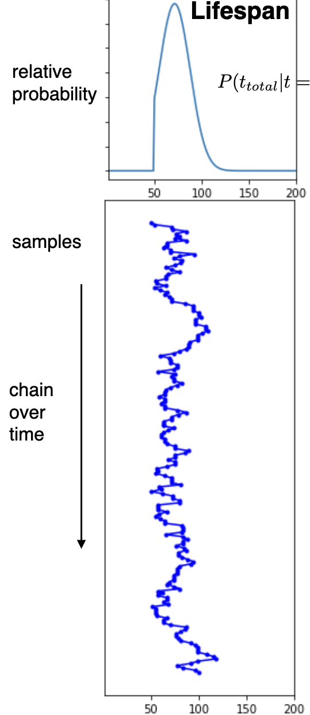
Part C: Implementation

